Slide 1
Python for Data Analysis lecture 1: Python Language Basics
Fatima Tokmukhamedova
f.Tokmukhamedova@iitu.edu.kz

Slide 2
Why Python for Data Analysis?
In the last 10 years, Python has gone from a bleeding-edge or “at your own risk” scientific computing language to one of the most important languages for data science, machine learning, and general software development in academia and industry.

Slide 3
Essential Python Libraries
NumPy
Pandas
Matplotlib
SciPy

Slide 4
NumPy
Short for Numerical Python
Contains:
• A fast and efficient multidimensional array object ndarray
• Functions for performing element-wise computations with arrays or mathematical operations between arrays
• Tools for reading and writing array-based datasets to disk
• Linear algebra operations, Fourier transform, and random number generation
• A mature C API to enable Python extensions and native C or C++ code to access NumPy’s data structures and computational facilities

Slide 5
pandas
Provides high-level data structures and functions designed to make working with structured or tabular data fast, easy and expressive.
pandas blends the high-performance, array-computing ideas of NumPy with the flexible data manipulation capabilities of spreadsheets and relational databases.
• Data structures with labeled axes supporting automatic or explicit data alignment —this prevents common errors resulting from misaligned data and working with differently indexed data coming from different sources
• Integrated time series functionality
• The same data structures handle both time series data and non–time series data
• Arithmetic operations and reductions that preserve metadata
• Flexible handling of missing data
• Merge and other relational operations found in popular databases (SQL-based, for example)

Slide 6
matplotlib
matplotlib is the most popular Python library for producing plots and other two-dimensional data visualizations
While there are other visualization libraries available to Python programmers, matplotlib is the most widely used and as such has generally good integration with the rest of the ecosystem.

Slide 7
SciPy
SciPy is a collection of packages addressing a number of different standard problem domains in scientific computing. Here is a sampling of the packages included:
command | description
scipy.integrate | Numerical integration routines and differential equation solvers
scipy.linalg | Linear algebra routines and matrix decompositions extending beyond those provided in numpy.linalg
scipy.optimize | Function optimizers (minimizers) and root finding algorithms
scipy.signal | Signal processing tools
scipy.sparse | sparse Sparse matrices and sparse linear system solvers
scipy.special | Wrapper around SPECFUN, a Fortran library implementing many common mathematical functions, such as the gamma function
scipy.stats | Standard continuous and discrete probability distributions (density functions, samplers, continuous distribution functions), various statistical tests, and more descriptive statistics

Slide 8
statsmodels
statsmodels is a statistical analysis package, contains algorithms for classical statistics and econometrics.
This includes such submodules as:
• Regression models: Linear regression, generalized linear models, robust linear models, linear mixed effects models, etc.
• Analysis of variance (ANOVA)
• Time series analysis: AR, ARMA, ARIMA, VAR, and other models
• Nonparametric methods: Kernel density estimation, kernel regression
• Visualization of statistical model results

Slide 9
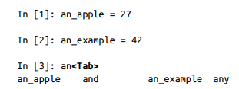
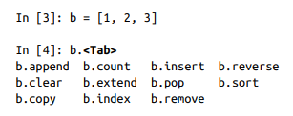
Tab Completion

Slide 10
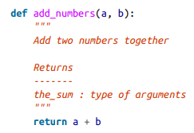
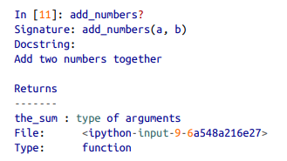
Introspection (?)

Slide 11
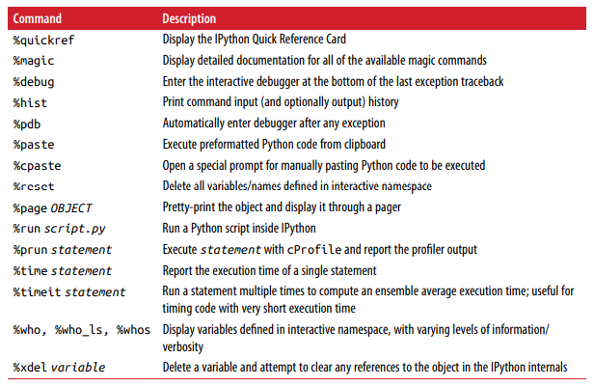
Magic Commands

Slide 12
Python language Basics
Python uses whitespace to structure code instead of using braces.
A colon denotes the start of an indented code block after which all of the code must be indented by the same amount until the end of the block.
Python statements do not need to be terminated by semi-colons. Semicolons can be used, however, to separate multiple statements on a single line.
Everything is an object
When you pass objects as arguments to a function, new local variables are created referencing the original objects without any copying.

Slide 13
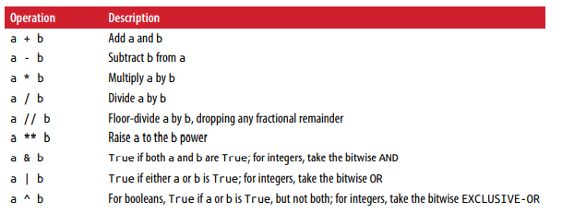
Binary Operators

Slide 14
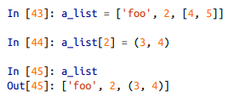
Mutable and immutable objects
Most objects in Python, such as lists, dicts, NumPy arrays, and most user-defined types (classes), are mutable. This means that the object or values that they contain can be modified
Others, like strings and tuples,
are immutable

Slide 15
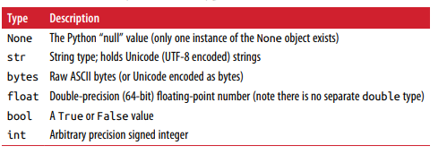
Scalar Types

Slide 16


Numeric types
Integer division not resulting in a whole number will always yield a floating-point number:
To get C-style integer division (which drops the fractional part if the result is not a whole number), use the floor division operator //:

Slide 17
Strings
You can write string literals using either single quotes ' or double quotes “
For multiline strings with line breaks, you can use triple quotes, either ''' or ""“
Python strings are immutable; you cannot modify a string
Many Python objects can be converted to a string using the str function
The backslash character \ is an escape character, meaning that it is used to specify special characters like newline \n or Unicode characters
Adding two strings together concatenates them and produces a new string

Slide 18
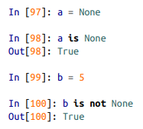
None
None is the Python null value type. If a function does not explicitly return a value, it implicitly returns None:

Slide 19
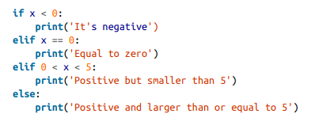
Control Flow
If, elif, and else

Slide 20

Loops
for loops
while loops
A while loop specifies a condition and a block of code that is to be executed until the condition evaluates to False or the loop is explicitly ended with break
Pass
n. It can be used in blocks where no action is to be taken (or as a placeholder for code not yet implemented); it is only required because Python uses whitespace to delimit blocks
Range
The range function returns an iterator that yields a sequence of evenly spaced integers

Slide 21

Ternary expressions
A ternary expression in Python allows you to combine an if-else block that pro‐ duces a value into a single line or expression. The syntax for this in Python is:
Here, true-expr and false-expr can be any Python expressions. It has the identical effect as the more verbose:

